Slide 1
CLASS IX ARTIFICIAL INTELLIGENCE PART A
CHAPTER 4.
ENTREPRENEURIAL SKILLS

Slide 2
Introduction
Business is an economic activity which is related with continuous and regular production and distribution of goods and services for satisfying human wants.
Businesses can be for-profit entities or nonprofit organizations.
Businesses cater to the needs of the society. But sometimes we find that there is a gap between what is needed and is available. This gap can be used as an opportunity by some people who are ready to take risk and fill the gap by providing necessary products and services. Such people are entrepreneurs.
What is Entrepreneurship:
The process of developing a business plan, launching and running a business using innovation to meet customer needs and to make a profit is entrepreneurship.
Enterprise
An enterprise is a project or undertaking that is bold and fulfills a need of the society which no one has ever addressed.
Entrepreneur: Recognize opportunity
Create Idea and start of a business
Grow the business
An entrepreneur is a person who is self-employed, is willing to take a calculated risk and brings in a new idea to start a business. It is, however, important to understand that all self-employed persons are not entrepreneurs, for example, a shopkeeper cannot be called an entrepreneur unless he/she introduces a new method or idea in the business

Slide 3
Role of Entrepreneurship
Economic Development — Money in Circulation
Social Development — Creation of Jobs
Improved Standard of Living — More things available to live a comfortable life
Optimal Use of Resources
More Benefits at Lower Prices Products and Services at Competitive Prices
Benefits of entrepreneurship: The various benefits include the following:
Do what you are interested in: Entrepreneurship allows you to start and do something you like using your hobbies and skills.
Work for yourself, and not for others: As an entrepreneur, you can work for yourself and not for someone else. You can decide the kind of work you like to do and how you want to do it.
Make profits for yourself: As an entrepreneur, you can decide how much money you want to
earn and how you want to earn it.
More risk, more profit: Even though there are risks in entrepreneurship, it allows you to decide
how much risk you want to take. Usually, the larger the risk, the bigger could be the profit!

Slide 4
Qualities of a Successful Entrepreneur:
Have Patience
Positive attitude
Hardworking
Should be confident
Types of Business Activities:
1. Product business :A business where a seller and buyer exchange an item, which can be seen and touched, is called a product based business. For example, a Sports Shop.
2. Service business : A business where a seller helps the buyer to finish some work. For example, a cricket coaching center.
3. Hybrid business: A hybrid is the one where the business is doing both selling product and selling services. eg: restaurants where the food itself is the product sold and the catering is the service provided.

Slide 5
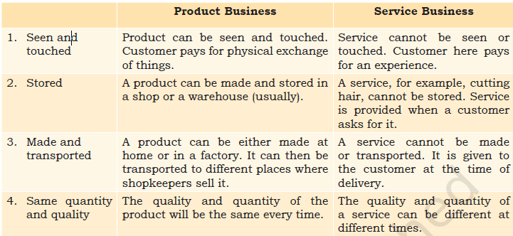

Slide 6
There are two types of product-based businesses
Manufacturing businesses :These are the businesses that make a product and sell it. Products are usually made in factories.
Trade businesses: These businesses buy and sell a product. They also transport the product from the factory to warehouses and then finally to shops near the customers. Examples of these business include wholesalers, distributors and retail shops.
Distinguishing Characteristics of Entrepreneurship and Wage Employment
Ability to take up risks
Believe in hard work and discipline
Adaptable and flexible to achieve the goals of enhancing quality and customer satisfaction
4. Knowledge of the product and services and their need or demand in the market
5. Financial literacy and money management skills
6. Effective planning and execution.

Slide 7
Wage Employment
In case of wage employment, there are always two parties. One is known as the employer and the other is the employee.
The wage employment does not involve too much risk but entrepreneurship involves taking certain amount of calculated risks.
However, the continuity of the service in case of wage employment depends on the terms and conditions laid down in the contract between the two parties and also sometimes the relationship between the employer and the employee.

Slide 8
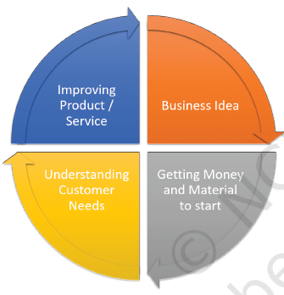
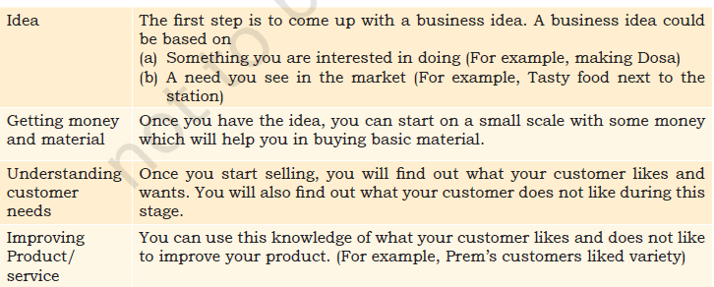
Entrepreneurship Development Process
Entrepreneurship development is the process of improving the skills and knowledge of entrepreneurs. It can take place through formal and informal learning system. In the formal learning system, training programmes are conducted to bring about awareness, knowledge and skills related to entrepreneurship.

